Slide 1

European road network analysis
Project for the course of “Complessità nei sistemi e nelle reti”
Andrea Bertogalli
218342
Accademic year 2022/2023

Slide 2

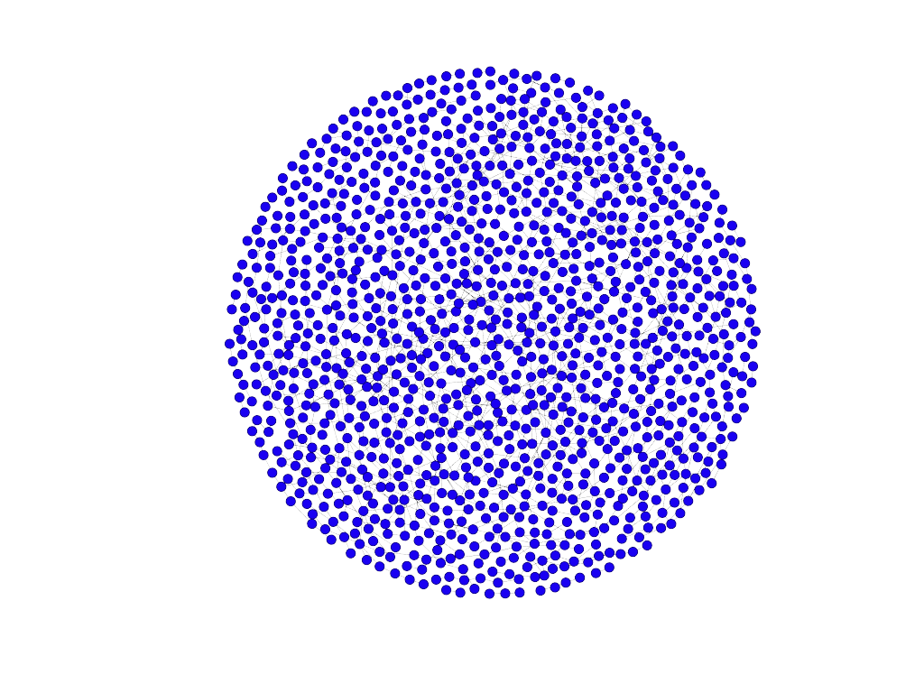
European road network analysis
Andrea Bertogalli, 218342
The dataset
The graph represents the European road network :
A node represents a city.
An edge represents a road directly connecting two cities.
There are 1174 nodes (cities), connected by 1417 edges (direct roads).
The network is undirected and unweighted.
Source: http://konect.cc/networks/subelj_euroroad/
Author: Lovro Šubelj (University of Ljubljana)
Related paper:
Robust network community detection using balanced propagation, L. Šubelj et. Al, 2011 (arxiv.org)
Fig.1: Fruchterman-Reingold layout plotted with Gephy.

Slide 3
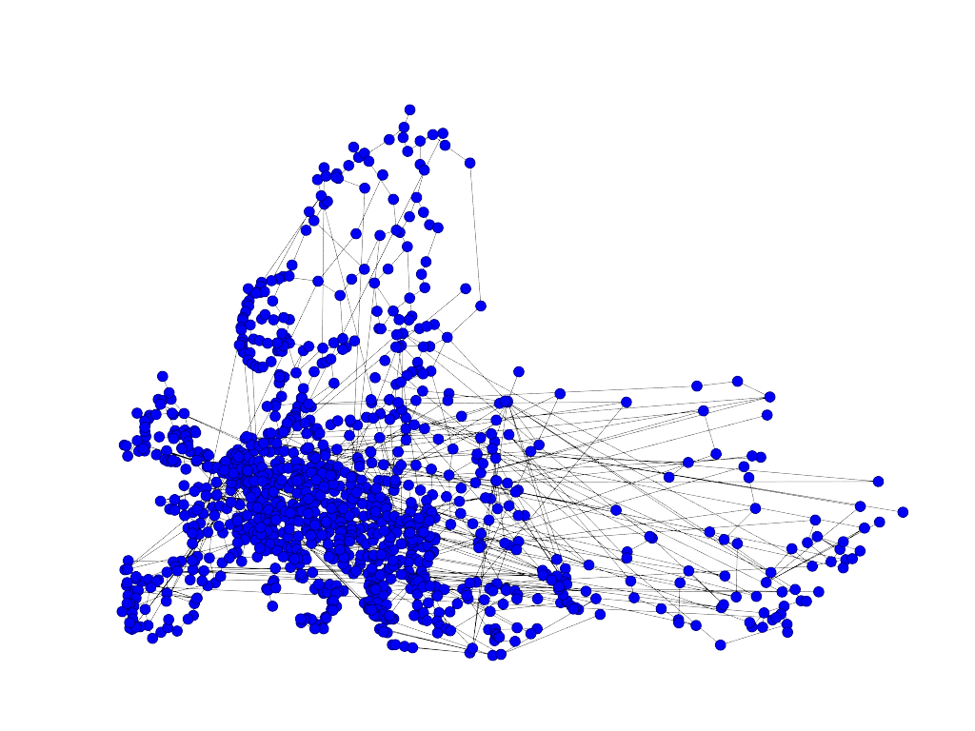
European road network analysis
Andrea Bertogalli, 218342
Pre-processing
Before starting to analyze the network, some pre-processing on the data is necessary in order to improve the visualization and, consequently, to facilitate further analysis.
We can automatically retrieve the latitude and the longitude of each city exploiting the nodes’ labels which correspond to the name.
Much better than the last slide…
Fig.2: GeoLayout plotted with Gephy.

Slide 4
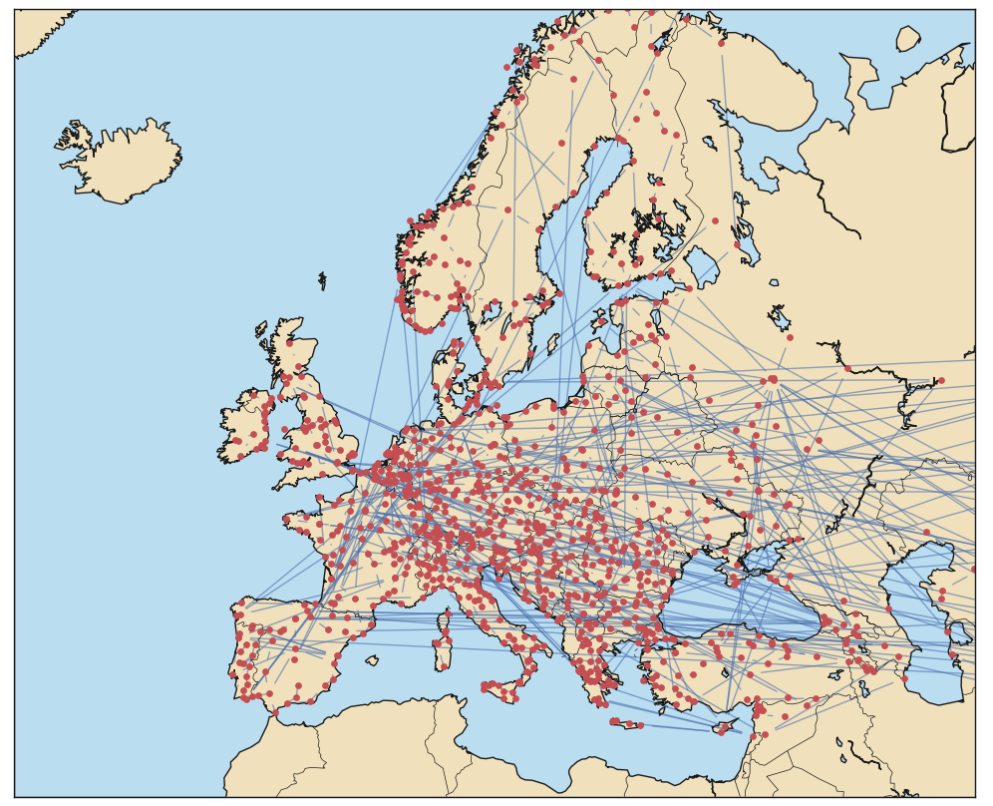
European road network analysis
Andrea Bertogalli, 218342
Pre-processing
We can also use a basemap to mark the Europe boundaries and see where the cities are located precisely.
Note that, due to the fact that coordinates are automatically retrieved, there may be some nodes drawn in the wrong position, but it’s just a graphical matter.
Fig.3: NetworkX graph plotted on a basemap using matplotlib.

Slide 5
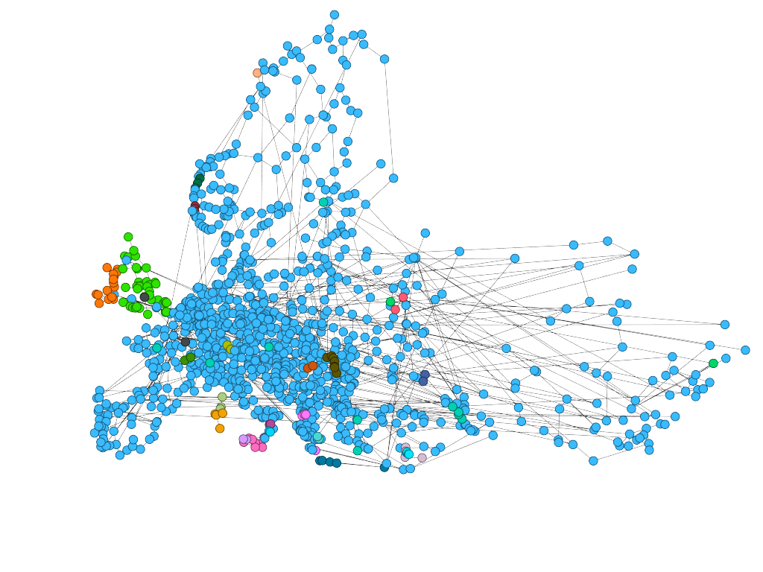
European road network analysis
Andrea Bertogalli, 218342
Network properties
By analyzing the network, it can be seen that there are multiple connected components but only one of them is relevant, so only the latter was analyzed.
The giant component has 1305 edges and 1039 nodes.
Fig.4: The network’s components plotted with Gephy (ligth blue = giant component).

Slide 6
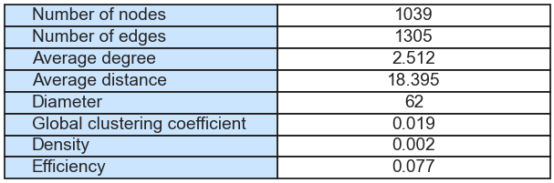
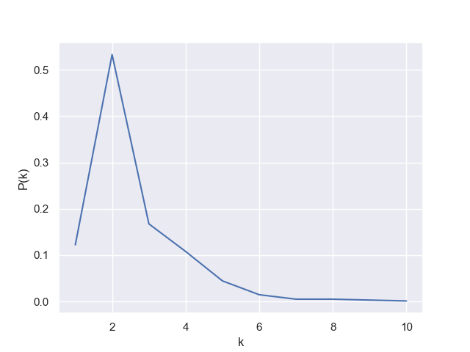
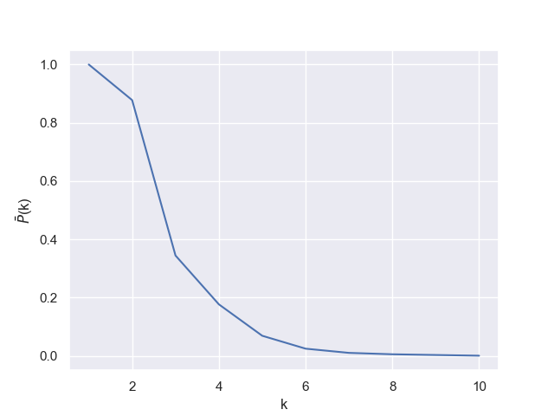
European road network analysis
Andrea Bertogalli, 218342
Network properties
Considering the average distance (≈18) we can state that the network is not a small word network, and considering the degree distribution we can say that the network seems to be scale-free but the maximum degree is only 10.
Fig.5: Some properties of the network.
Fig.6: The degree distributions of the network.
Fig.7: The cumulated degree distributions of the network.

Slide 7
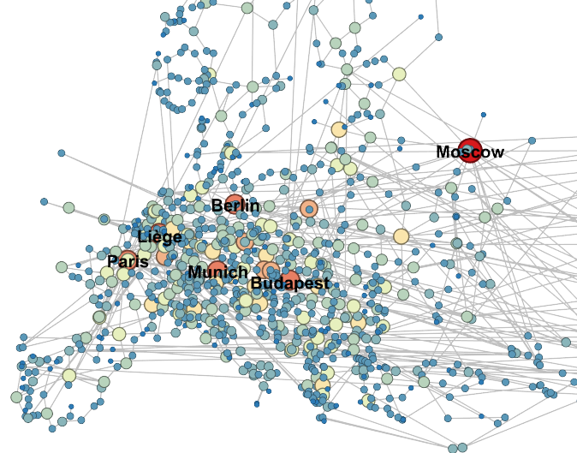
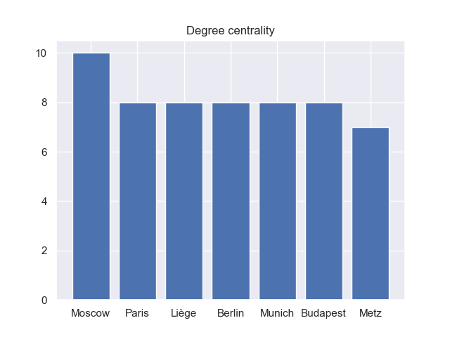
European road network analysis
Andrea Bertogalli, 218342
Centralities - Degree
Fig.8: Top seven for degree.
Fig.9: Degree centrality plotted with Gephy, darker means higher degree

Slide 8
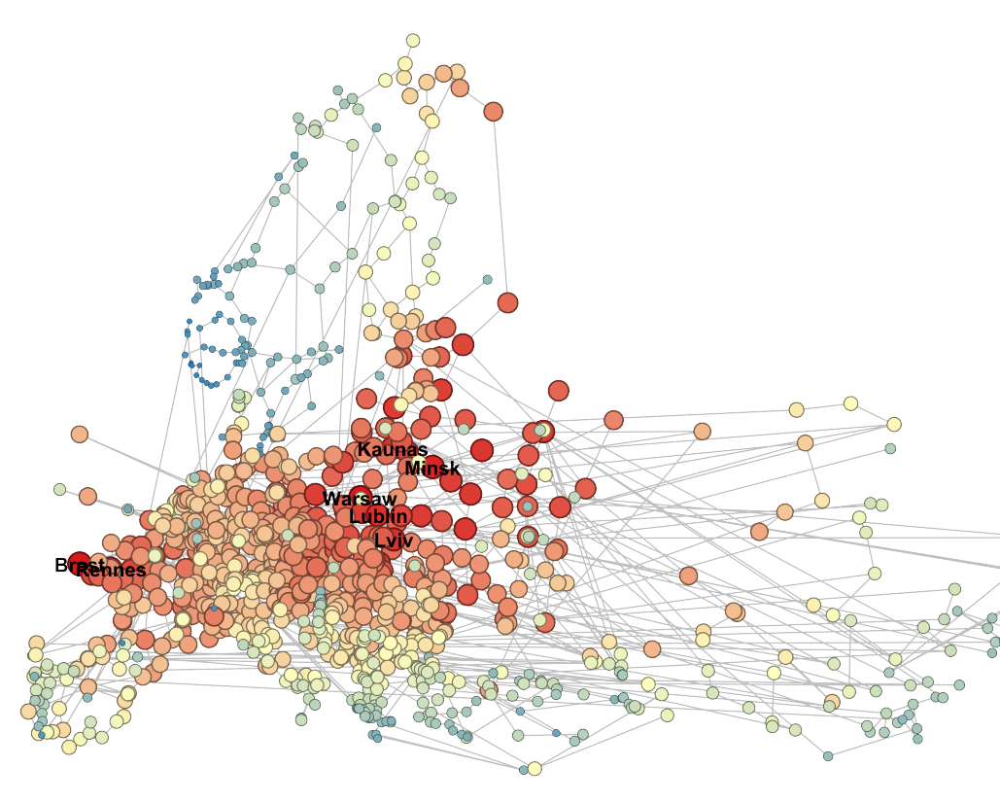
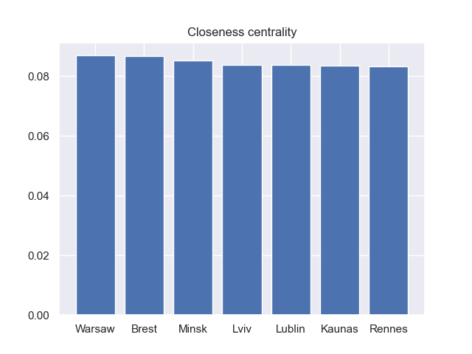
European road network analysis
Andrea Bertogalli, 218342
Centralities - Closeness
Fig.10: Top seven for closeness centrality score.
Fig.11: Closeness centrality plotted with Gephy, darker means higher
closeness score

Slide 9
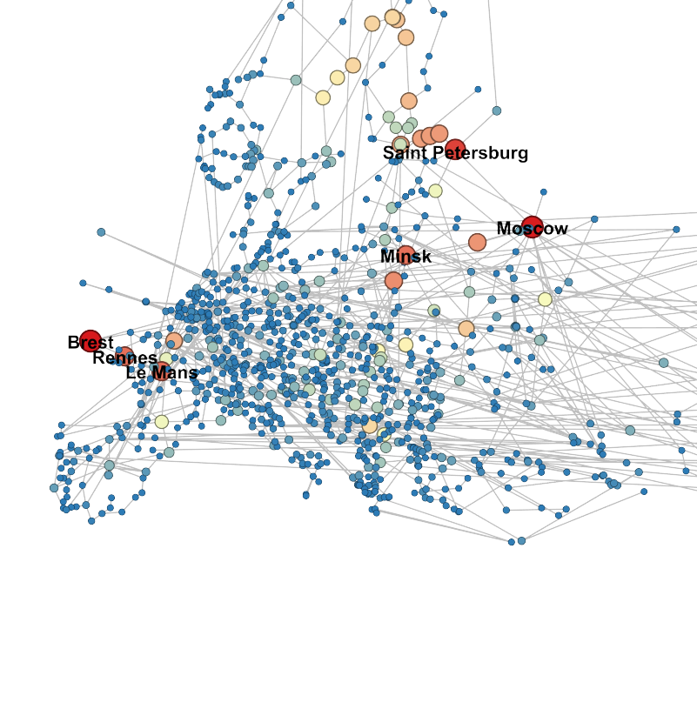
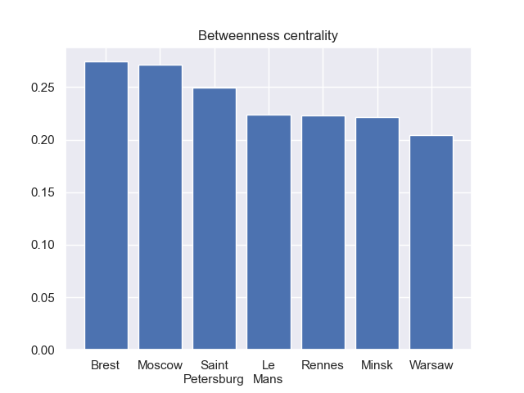
European road network analysis
Andrea Bertogalli, 218342
Centralities - Betweenness
Fig.12: Top seven for betweenness centrality score.
Fig.13: Betweenness centrality plotted with Gephy, darker means higher
betweenness score

Slide 10
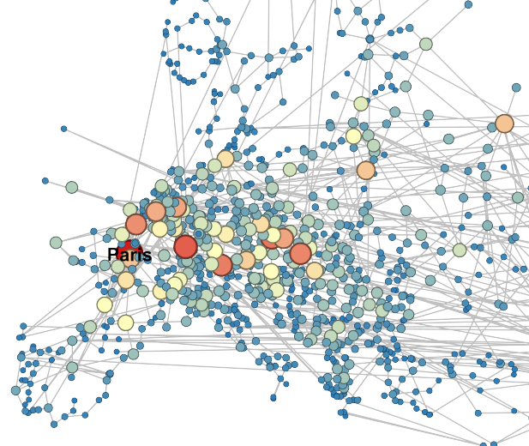
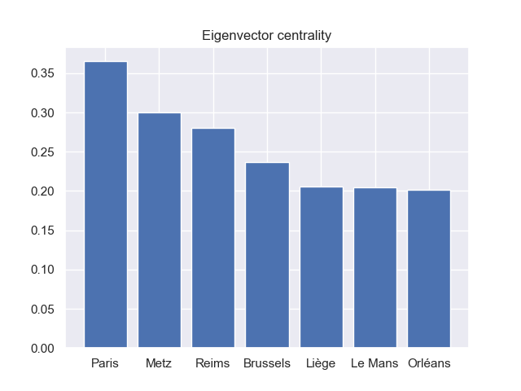
European road network analysis
Andrea Bertogalli, 218342
Centralities - Eigenvector
Fig.14: Top seven for eigenvector centrality score.
Fig.15: Eigenvector centrality plotted with Gephy, darker means higher
eigenvector score

Slide 11
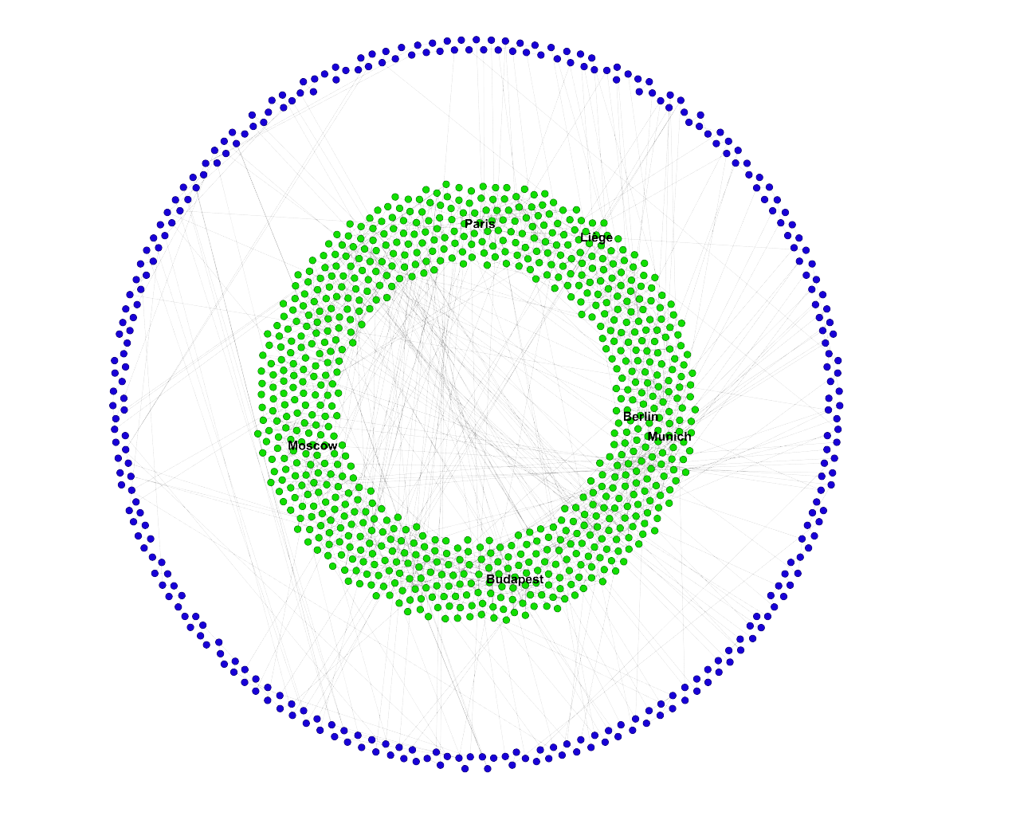
European road network analysis
Andrea Bertogalli, 218342
Core-Periphery analysis
By applying the decomposition algorithm we notice that the network consists of only two shells. This binary division allows us to distinguish a periphery (1-Shell), composed by 303 nodes, and a core (2-Shell), composed by 736 nodes.
In the figure the blue nodes represent the 1-Shell while the green one the 2-Shell.
K = 2
K = 1
Fig.16: K-Core decomposition computed with networkX and plotted with Gephy (Dual Circle Layout).

Slide 12
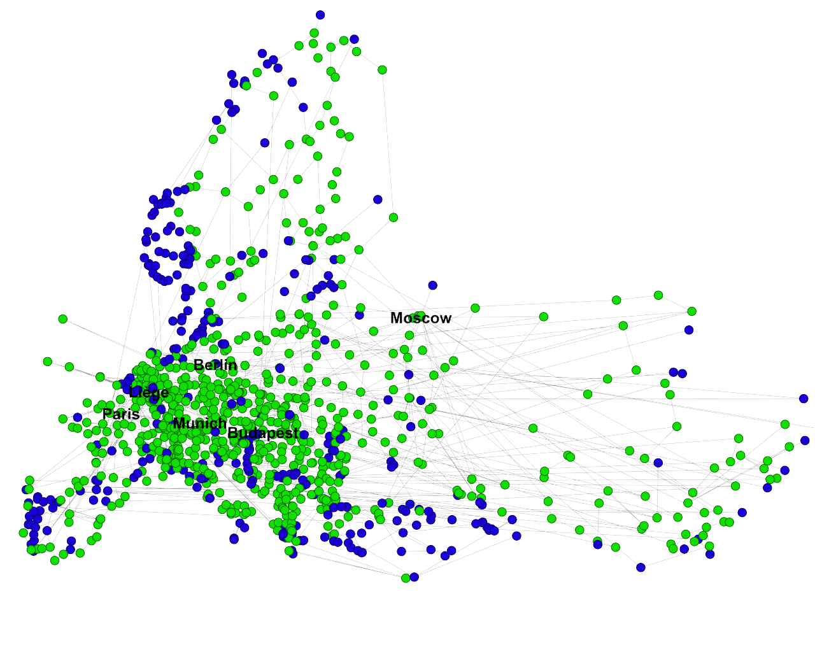
European road network analysis
Andrea Bertogalli, 218342
Core-Periphery analysis
It’s interesting to note that the periphery coincides fairly well with the geographic periphery of Europe, this highlights that the European road network is more sparse in the periphery while more dense in the core.
Fig.16: K-Core decomposition computed with networkX and plotted with Gephy.

Slide 13
Thanks for your attention
European road network analysis
Andrea Bertogalli
218342
Accademic year 2022/2023

